Slide 1




Introduction to the Social Care Network
A New Way to Support Clients – And Get Reimbursed!
Presented on July 18, 2025
1

Slide 2


Our Shared Purpose
Overview

Slide 3
Our Shared Purpose
What: A commitment to Whole-Person care with a need to address social determinates of health (food, housing, transportation, etc.)
Why: Your voice and expertise are essential to making this system inclusive and impactful
How: The Social Care Network offers tools and partnerships to screen, refer, and support individuals more effectively

Slide 4
What is the Social Care Network
Overview

Slide 5
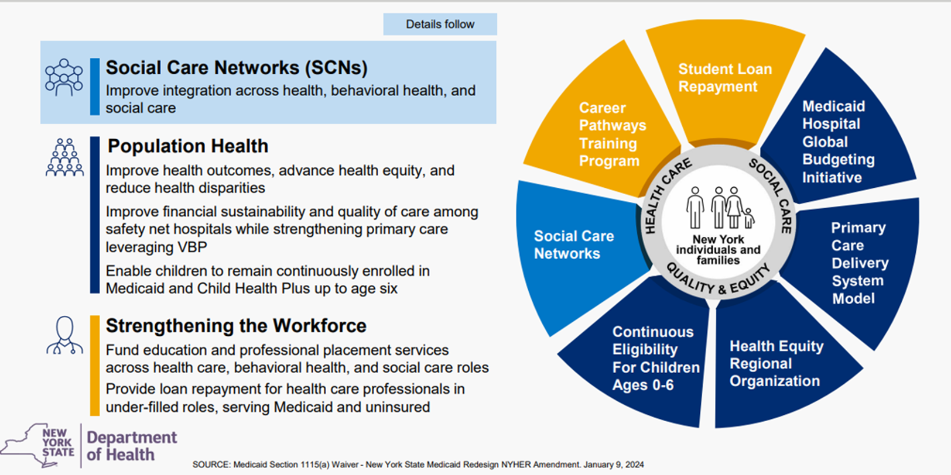


NY Health Equity Reform (NYHER) 1115 Waiver Amendment Initiatives
5
Notes:
Waivers refer to special permission granted by the federal government that allows a state to ‘waive’ certain federal requirements – usually in Medicaid or other public assistance programs, so the state can try new or customized approaches to delivering services.
Population Health’s core component is Health Equity Regional Org (HERO) and is coordinated through United Hospital Fund
Strengthening the Workforce is being in led in part through ‘career pathways training’ led by SEIU 1199

Slide 6
Screening for: Unmet Enhanced Health
Related Social Needs (HRSN) Services
Housing Supports
Navigation
Nutrition
Nutritional counseling and classes
Transportation
Case Management
Pre-tency (applications) & tenancy sustainability (establishing a bank account)
Home accessibility & safety modifications such as handrails and ramps, grab bars, etc.
Medically tailored or clinically appropriate meals home-delivered meals
Fruit and vegetable and nonperishables
Reimbursement for public and private transportation to connect to HRSN services and HRSN case management activities
Level 1 – navigation and linkage existing State and Federal Social Services
Level 2 – outreach, referrals, and education, including linkages to other state and federal programs
Available to fee-for-service and managed care
Home remediation & education such as addressing mold and pest
Cooking Supplies
Food prescriptions
Connections to clinical case management
Connection to childcare, employment, education, interpersonal violence resources
Community Transitional Services
Rent/utilities for 6 months
Medical Respite
6

Slide 7
Region 3: Hudson Valley
Overview

Slide 8

Hudson Valley
Goal: Improve health outcomes and reduce healthcare costs by addressing social determinants of health through a coordinated, whole-person care model
Counties Covered: Dutchess, Orange, Putnam, Rockland, Sullivan, Ulster, Westchester
Over 600,000 attributed Medicaid member lives to be screened
Funding & Reimbursement: Services are reimbursed through Medicaid Managed Care plans via the Social Care Network (SCN) Lead Entity – Hudson Valley Care Coalition
8

Slide 9

County Governments
Healthcare Systems*
MCOs & MLTCs
County Governments
Department of Mental Health
Department of Social Services
Department of Health Department of Aging
Department Office for People with Disabilities
Hudson Valley’s Community Based Healthcare
Eco-System
Medicaid Members
Community Based Organizations delivering health related social needs
Organizations servicing people with different abilities
SCN Lead Entity
Primary Care
Behavioral Health
Organizations serving LGBTQA+
Medicaid Members
MCO = Managed Care Organizations
MLTC = Managed
Long-Term Care
Healthcare Systems
Ambulatory practices
Discharge Planners
Emergency Departments
Hospitals

Slide 10
Hudson Valley Care Coalition
Care in Every Connection

Slide 11
Current Network Development
Over 115 Community Based Organization (only 10 are Disability providers) have contracted with HVCC to provide Health Related Social Needs (HRSN) related services
  Screening
  Navigating/Care Managers
  Accepting Referrals and Providing Services
System Hospitals + Primary Care Integration
  Joining our Network and screening and in some cases even navigating and providing services
  Others are referring to our Community Based Organizations or we are discussing co-location service opportunities
County + Local Government participation on our IT Platform
  Allows for easier access for referral for either Level 1 or 2 services
11

Slide 12
Financial Streams
Community Based Organizations (CBOs) and Health Related Social Needs (HRSN) providers are reimbursed for the services they provide:
  Screening
  Care Navigation Services
  Enhanced Health Related Social Needs (HRSN) Care Management
  Housing
  Food
  Transportation
Capacity Building Awards are designed to help CBOs build and strengthen their network and can be used in several different ways
  IT Infrastructure
  Equipment
  Training and Onboarding Workforce
12

Slide 13

Outreach and Education Plan
Education + Raising Awareness
  Resources offered through the SCN
  Messaging will be simple and impactful and relatable with visuals
Partnerships + Collaboration
  Attend community events and activities to build relationships with Members, organizations, and raise awareness on the resources
Impact + Outcomes
  Highlight success stories. Share compelling narratives of individuals and families who have benefited from programs
  Present data and statistics
  Showcase community impact
13

Slide 14

What You Can Do
Overview

Slide 15

What You Can Do
Join the Hudson Valley Care Coalition’s Social Care Network
  Screen your clients and get reimbursed!
  Navigate your clients and get reimbursed!
  Provide referrals for clients
  Help us educate others about the Social
  Care Network
15

Slide 16
Thank You!
16

